Slide 2
CS 557 STATISTICAL PATTERN RECOGNITION & LEARNING
WELCOME TO THE COURSE!
INTRODUCTION
Mehreen Saeed
August 2016

Slide 3



A SIMPLE EXAMPLE
WHAT IS THE LABEL ??? + OR -

Slide 4


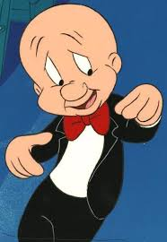




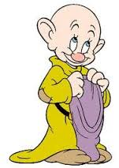
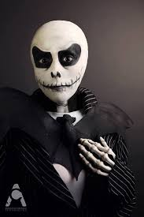

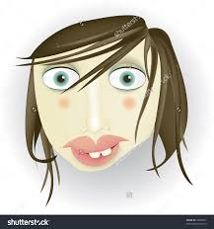

LEARN FROM EXAMPLES/SUPERVISED LEARNING
+ EXAMPLES
- EXAMPLES
NOW DECIDE THE LABEL

Slide 5
UNSUPERVISED LEARNING
No labels are available, make two or more groups of the above using some common characteristics

Slide 6
SEMI-SUPERVISED LEARNING
- label
+ label
+ label
Data exists in huge amounts and very few labeled examples are available so unlabeled data is used for training

